Slide 1
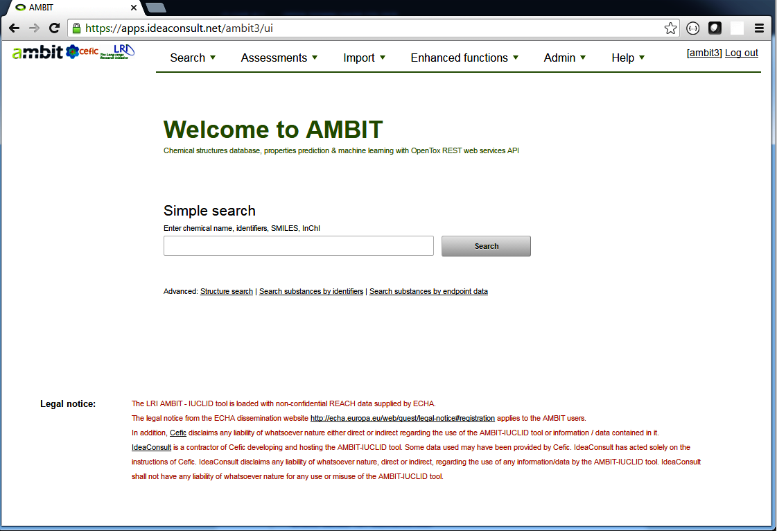
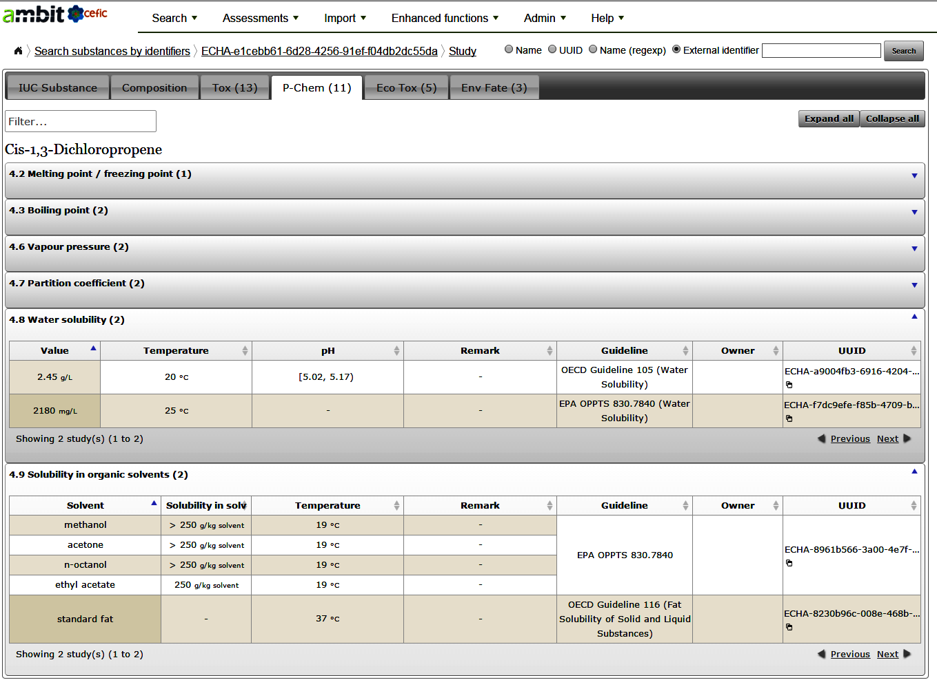
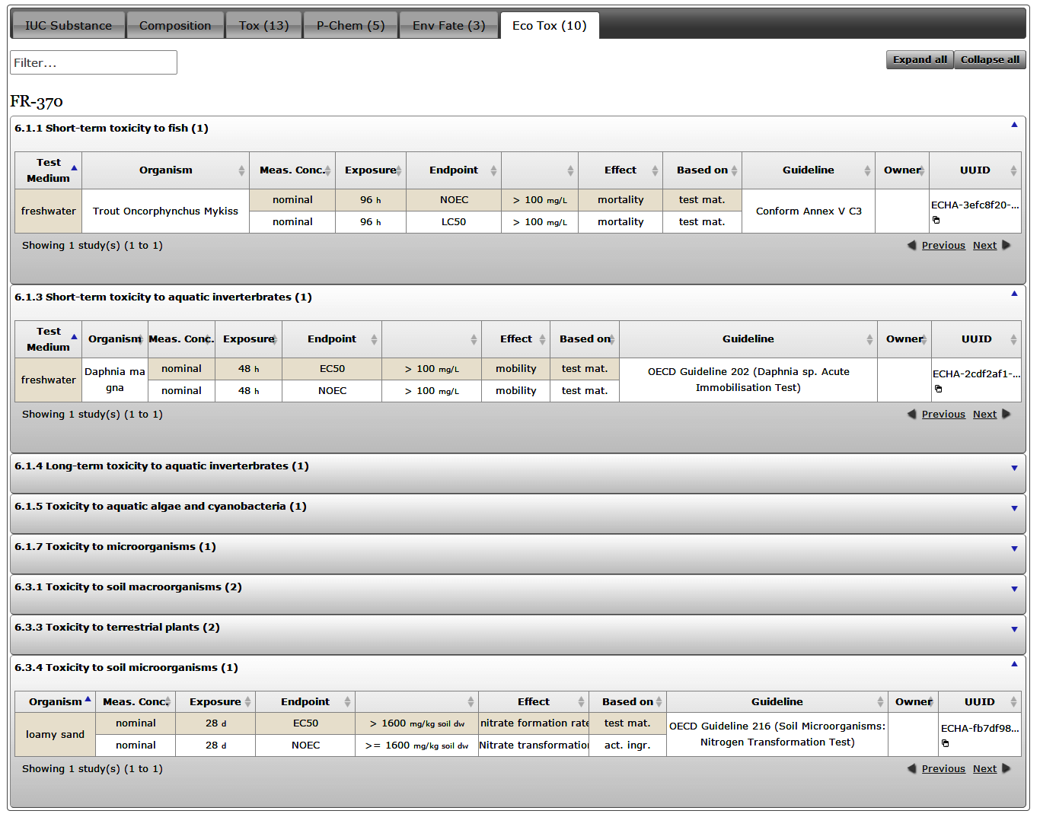
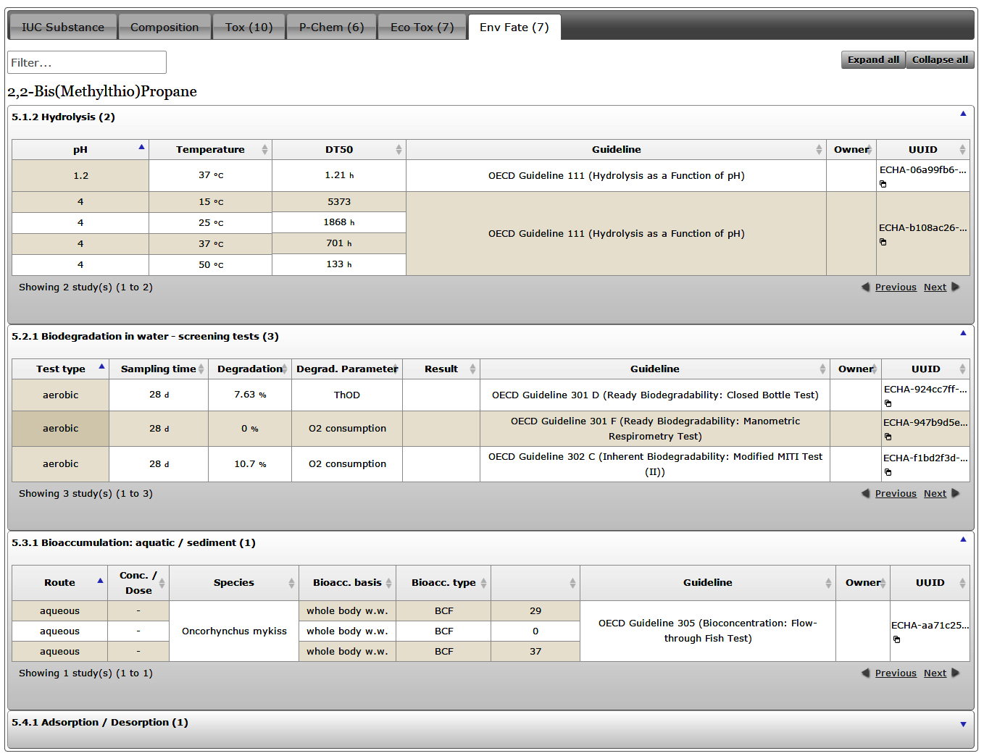
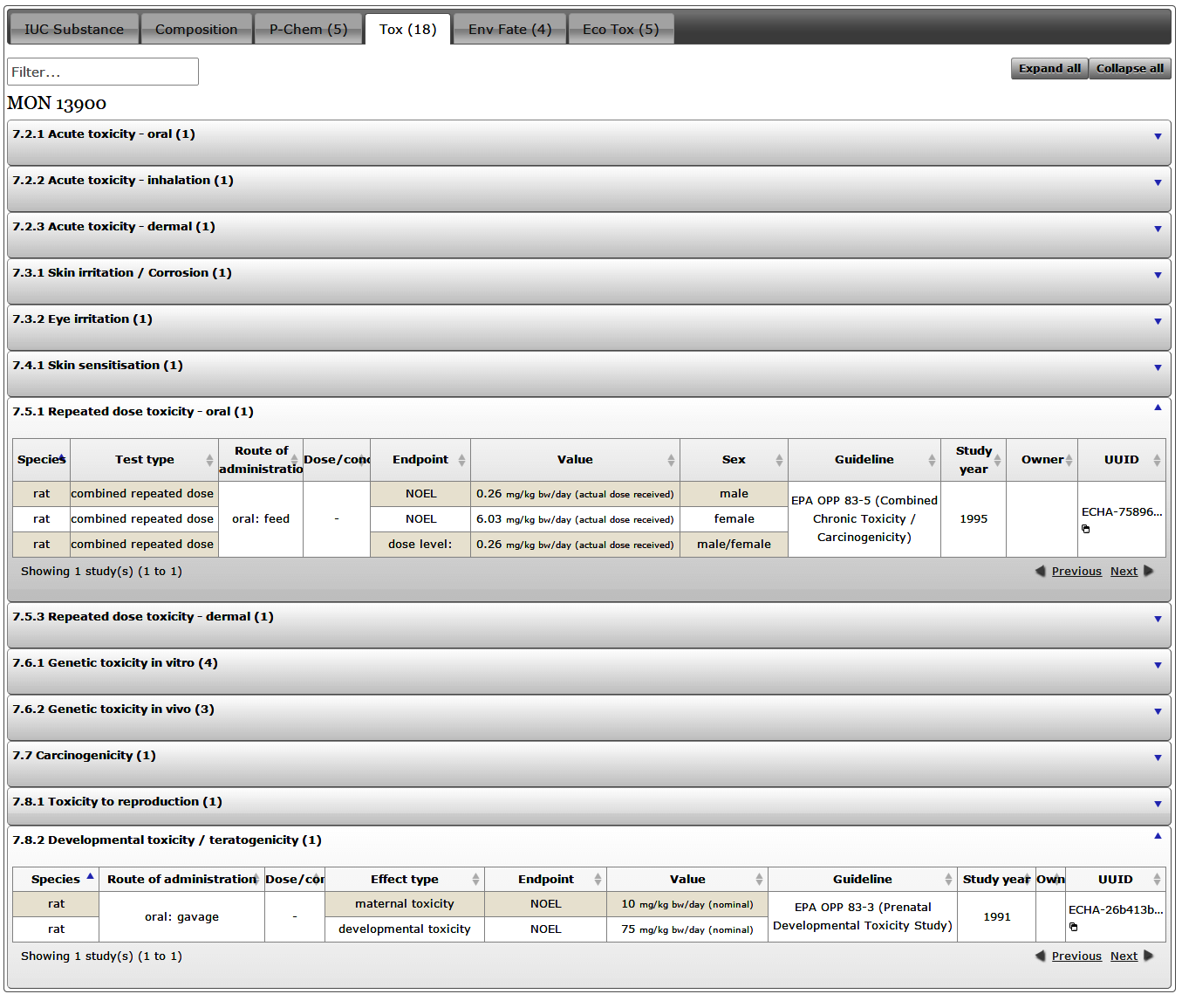
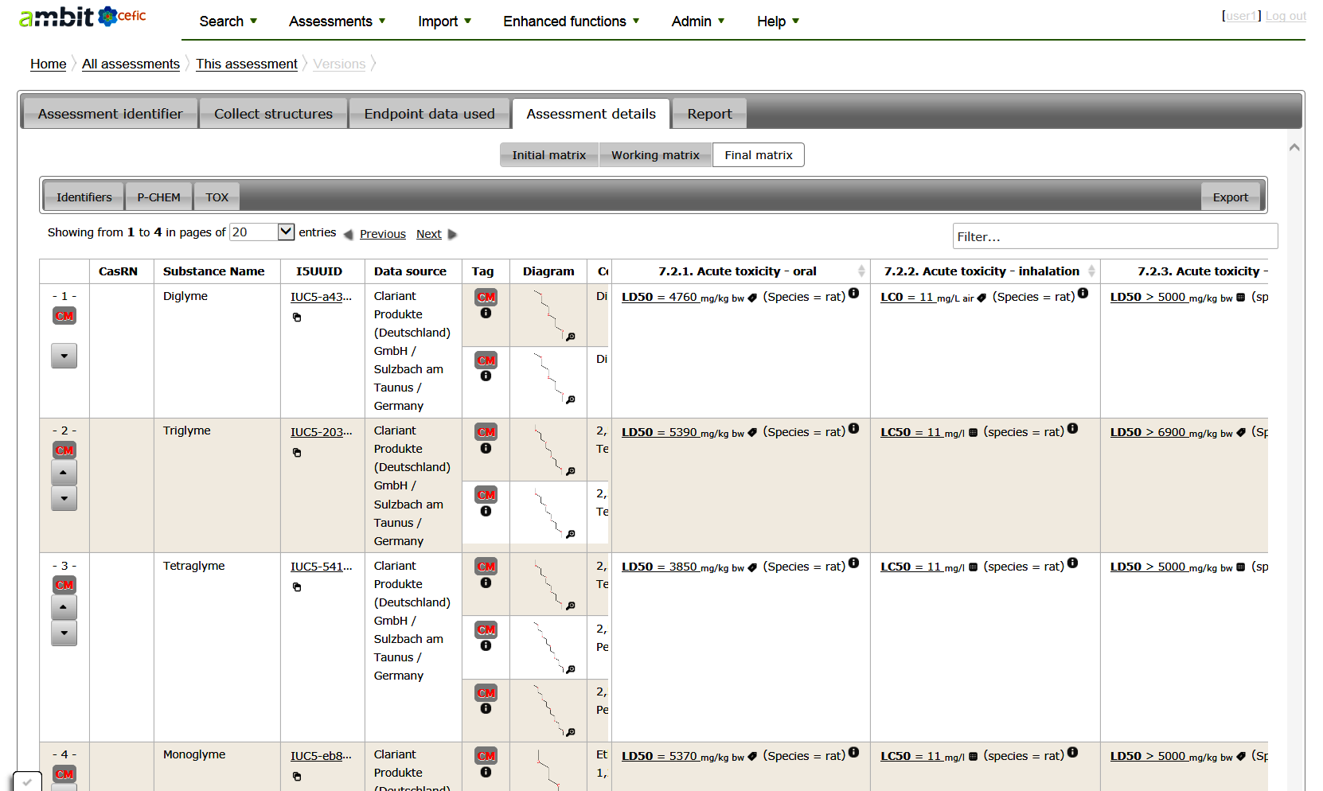
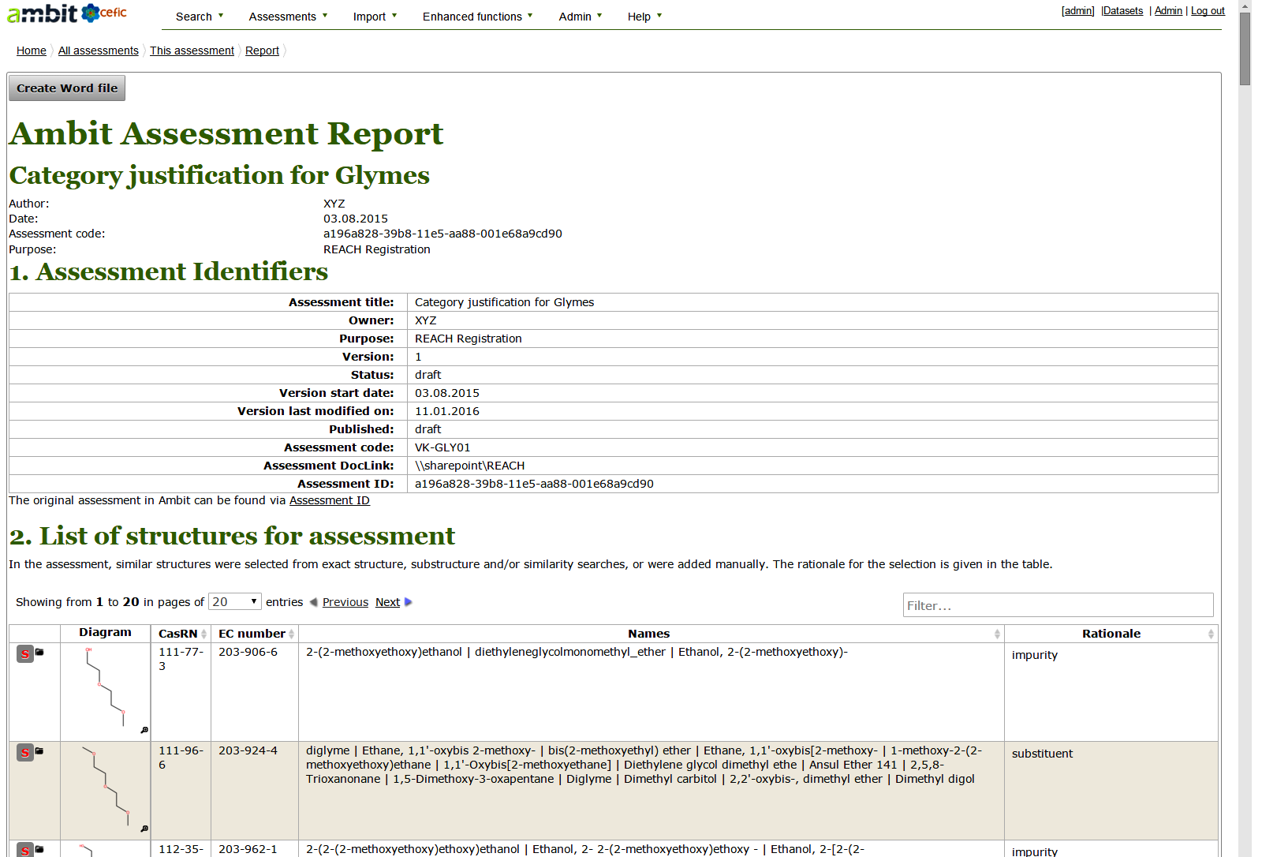
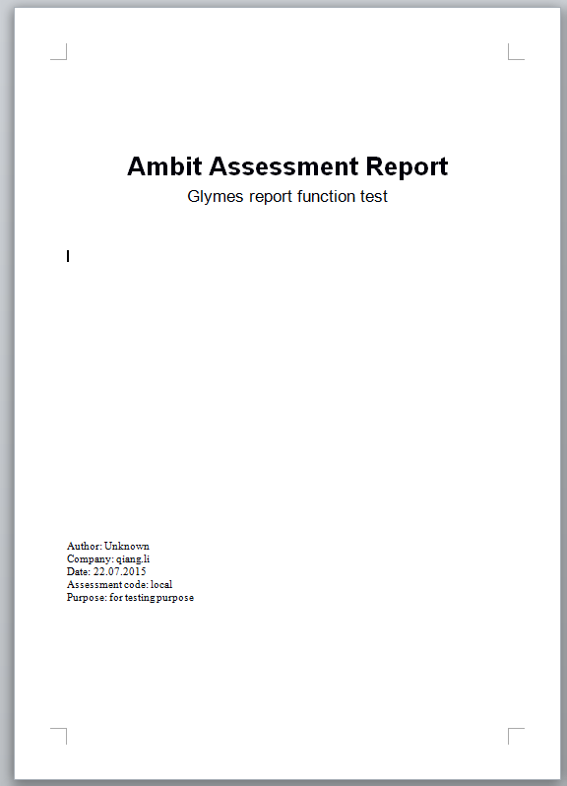
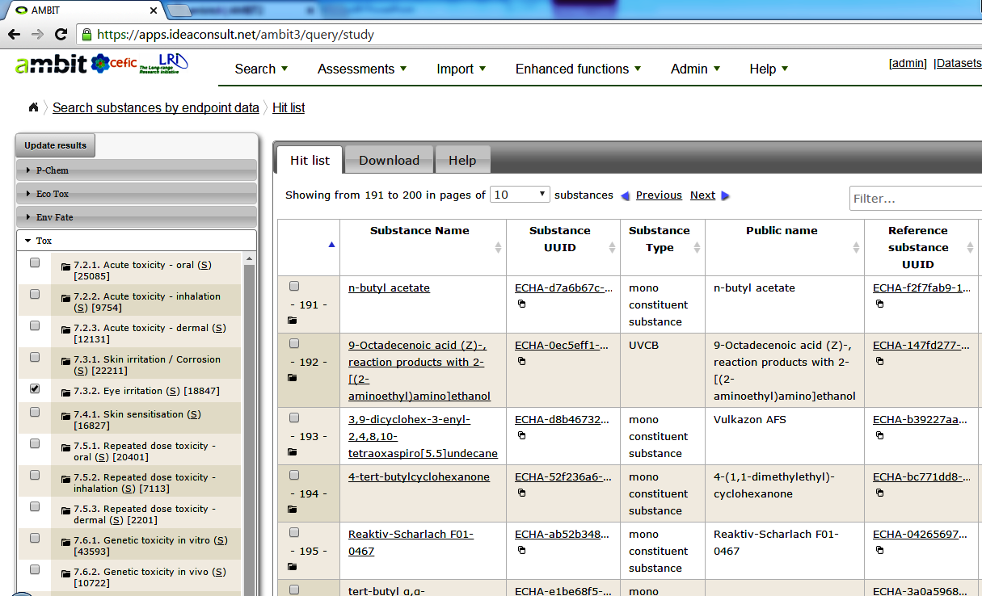
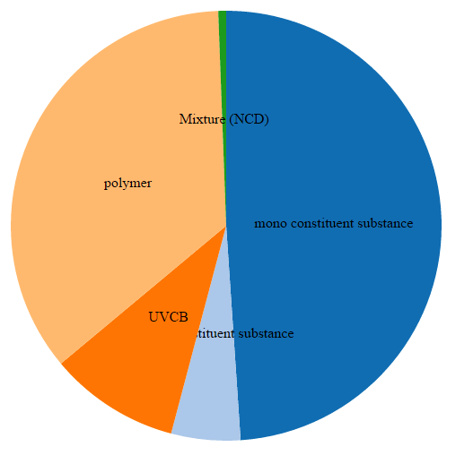
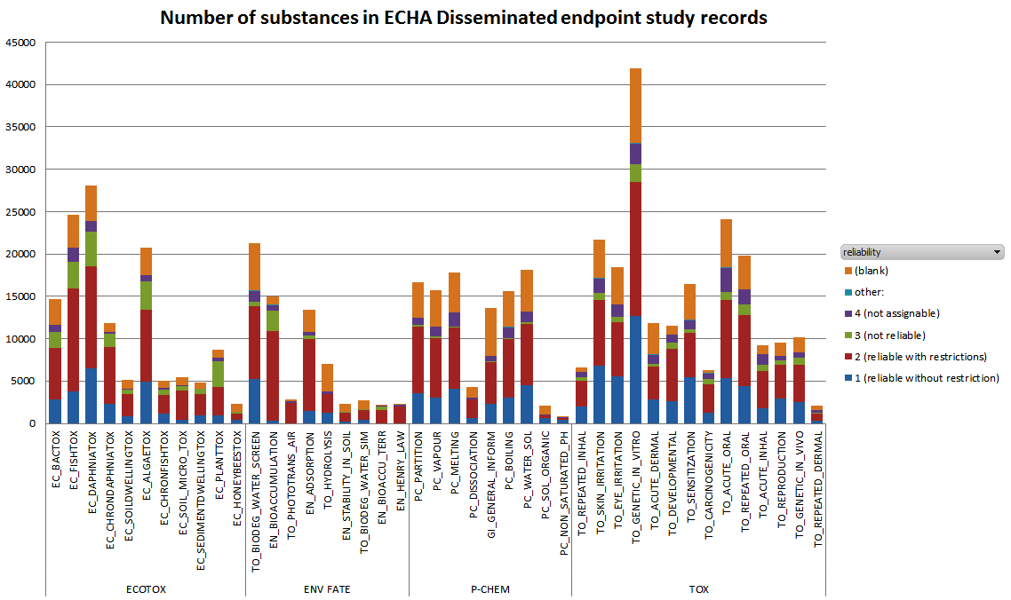
Linking LRI AMBIT Chemoinformatic system with the IUCLID Substance database to Support Read-across of Substance endpoint data and Category formation
N. Jeliazkovaª , V. Koch^{b}, Q. Li^{b}, U. Jensch^{b}, J. Schneider-Reigl^{b}, R. Kreiling^{b} , I. Georgievª, B. Hubesch^{c}
ª Ideaconsult Ltd., 4, Angel Kanchev Str., 1000 Sofia, Bulgaria; ^{b}Clariant Produkte (Deutschland) GmbH, Am Unisyspark 1, 65843 Sulzbach, Germany;
^{c} CEFIC, 4 Avenue E. Van Nieuwenhuyse, 1160, Brussels, Belgium
Introduction
Read-across and category formation are indispensable techniques in safety assessments of chemicals. The read-across approach is used on average in 20% of the Endpoint Study Records, while QSAR is used in less than 1% of the dossiers, according to European Chemical Agency reports. Although many tools are available, only a limited number is capable to provide easily accessible data on substance identity, composition together with chemical structures and high quality endpoint data.
Linking AMBIT with IUCLID
IUCLID
User Interface
AMBIT
http://ambitlri.ideaconsult.net
Chemical substances and endpoint data in AMBIT
The AMBIT software, funded initially within the CEFIC LRI programme, provides a web service and user friendly web interface to a chemical database, various chemical structure search facilities and toxicity prediction models. AMBIT data model enables representation of chemical substances in real industry conditions by supporting complex compositions (including impurities, additives, UVCB). AMBIT is designed to enable data import from several databases, including the International Uniform Chemical Information Database (IUCLID). Currently AMBIT supports manual upload of i5z files exported from IUCLID or semi-automatic import via IUCLID Web services. The chemical structures already contained in AMBIT are automatically linked to constituents/impurities/additives of the imported substances. The flexible data storage and visualization allows for user friendly presentation of study data (physicochemical properties, fate and hazard information) and composition.
(Semi) Automated Selective Date Exchange
Via Web services
Via exported i5z files
IUCLID
Web Server
Configuration
Module
AMBIT
Web Server
Workflow for read across and category formation
Assessment identifier | Collect structures | Endpoint data used | Assessment details | Report
Define assessment parameters
Assessment identifier | Collect structures | Endpoint data used | Assessment details | Report
Phys-chem
Ecotoxicity
Collect structures | List of collected structures
Use exact structure and similarity search to collect the structures for read-across/category formation`
Assessment identifier | Collect structures | Endpoint data used | Assessment details | Report
Search substance(s) | Selection of endpoints
Search for substances having the collected structures as constituent
Select all relevant endpoints which have to be displayed in the Data Matrix
Assessment identifier | Collect structures | Endpoint data used | Assessment details | Report
Initial matrix | Working matrix | Final matrix
The working matrix displays all selected endpoint data of the substances and allows gap filling
Data gaps can be filled by opening data input pop up window
Justification has to be given as well
Assessment identifier | Collect structures | Endpoint data used | Assessment details | Report
Environmental fate
Toxicity
Final matrix
Assessment report
Read-across workflows in AMBIT
Comprehensive assessment workflows are developed for read-across and category formation based on all the data available in AMBIT. The assessment workflow facilitates the search for target and source structures, generating data matrices, gap filling and generating assessment reports with predefined formats automatically. The enhanced AMBIT facilitates drafting and improves quality for read-across and category formation and will be a useful tool for experts responsible for substance assessments.
Private assessments
The assessments are only visible to the owner by default, read/write access for other users are explicitly assigned. AMBIT uses role based access control.
After gap filling and removal of inappropriate data, the final data matrix can be established
An assessment report can be established as soon as the final data matrix has been created
The report can be exported into MS Word
Summary
AMBIT is an Open Source Web Application (LGPL license). LRI AMBIT-IUCLID tool is loaded with REACH data subject to the legal notice. Substance composition and IUCLID import is supported. The comprehensive search functionality allowing structure search, substructure search, and similarity search even in databases not designed for, such as IUCLID, in order to find substances appropriate for read-across and category approaches. It also enables the inclusion of impurities (important in real industrial conditions) in substance search requests. User interface for creating read across assessment and generating reports is available in online and downloadable versions.
Download and installation options
LRI AMBIT – IUCLID tool download http://cefic-lri.org/lri-toolbox/
Installation on a local laptop/desktop or company Intranet server
Shared database and web server. Clients only need a web browser.
Publicly available online https://ambitlri.ideconsult.net
Clients only need a web browser, registration by email
IT Technology
Server: Java 7; Tomcat 7.x; MySQL >= 5.6, REST API
Clients: Microsoft IE; Mozilla Firefox; Google Chrome , JavaScript
Libraries: open source Java library – CDK (http://cdk.sf.net ); AMBIT (http://ambit.sf.net )
The LRI AMBIT- IUCLID tool is loaded with non-confidential REACH data supplied by ECHA
http://echa.europa.eu/view-article/-/journal_content/title/echa-gives-out-registration-data-to-support-development-of-non-test-methods
Technical support
contact Ideaconsult Ltd, Sofia
www.ideaconsult.net ,
email: support@ideaconsult.net
Acknowledgements
References
ECETOC European Center for Ecotoxicology and Toxicology of Chemicals, Technical Report 116, 2012 http://www.ecetoc.org/technical-reports
LRI Long-range Research Initiative of Chemical Industry http://www.cefic-lri.org
AMBIT A Software for Cheminformatic Data Management http://ambit.sf.net
Jeliazkova, N.; Jeliazkov, V., J. Cheminform., 3, 2011, 18. doi:10.1186/1758-2946-3-18.
IUCLID The International Uniform Chemical Information Databaseh http://iuclid.eu/
The legal notice from the ECHA dissemination website http://echa.europa.eu/web/guest/legal-notice#registration applies to the AMBIT users. In addition, Cefic disclaims any liability of whatsoever nature either direct or indirect regarding the use of the AMBIT-IUCLID tool or information / data contained in it.

