Slide 1


CEFIC-LRI project DustEx
DustEx Final report
ETH zürich
2016-03-01

Slide 2
Project Structure
Notes:
Newly included finished tasks are tasks 2.5 and 2.6 on uncertainty assessment and the complete work package 4.

Slide 3
DustEx Model (WP 2)
Vilma Sukiene

Slide 4
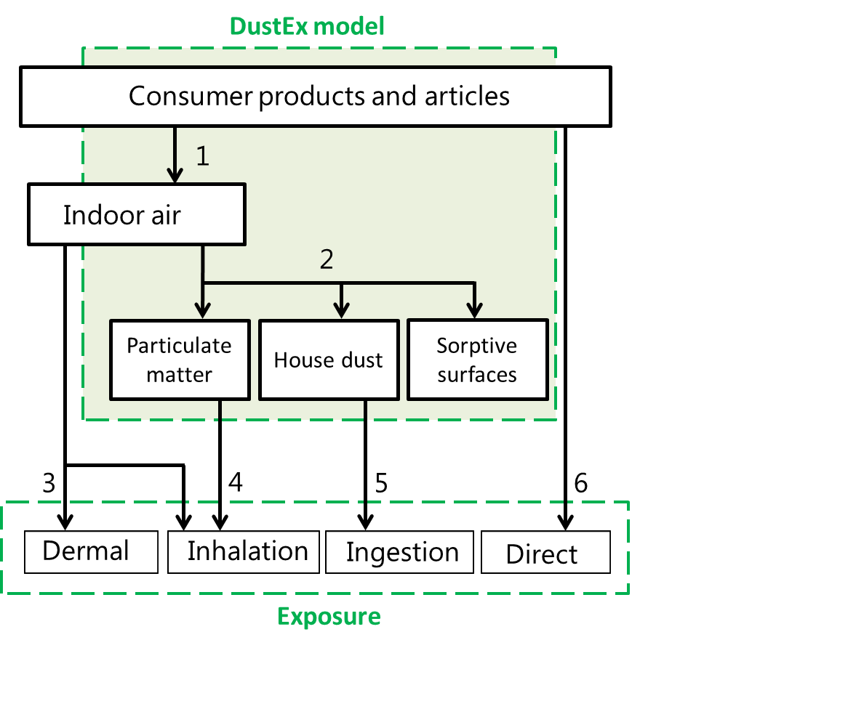
Exposure assessment/ Pathway comparison

Slide 5
Model Structure
evaporation
direct product contact
indoor air
product
exposure
equation 2
vacuum cleaning/
track out
partitioning
ingestion
dust
equation 15
equation 35
equation 17
deposition/
re-suspension
partitioning
inhalation
airborne particles
equation 12
ventilation
equation 34
sorption/desorption
surfaces
equation 8
partitioning
lipid layer on skin
dermal absorption
equation 32
inhalation
ventilation

Slide 6
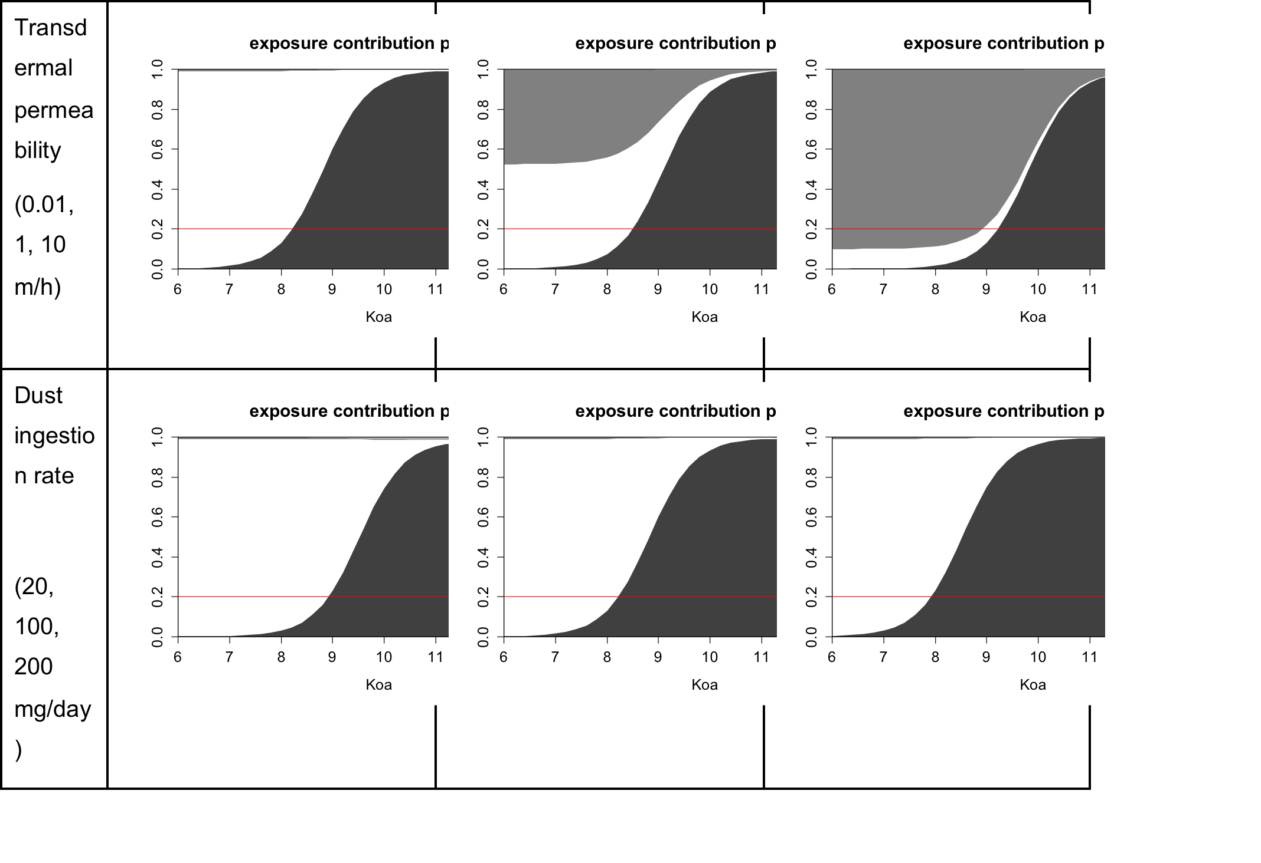
Uncertainty assessment
The relative contribution of the dust exposure pathway is most sensitive to changes in k_{p_g} (transdermal permeability) and A_{dust_ingest}.
The combined effect of the uncertainty in k_{p_g} and A_{dust_ingest} leads to a variation in the benchmark K_{oa} of two orders of magnitude (the log K_{oa} varies from 8 to 10).
For all other parameters the effect on the inter-pathway comparison is limited.

Slide 7
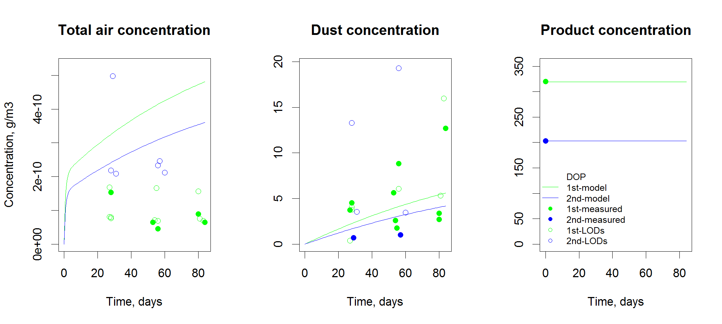
Validation
Figure 46 report

Slide 8
Field Study (WP3)
Vilma Sukiene

Slide 9

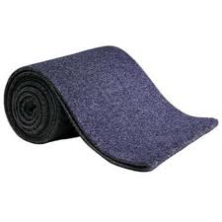
Products
Transfer process:
Product:
intentional release, i.e. spraying
spray
evaporation
evaporation (with thermal exposure)
3 plastic products
Custom-made
direct diffusion + evaporation
abrasion + evaporation
carpet
Vilma Sukiene

Slide 10
Model substances
Plasticizers
Insecticide
Phthalates
Adipates
Pyrethroid
²H₄-DEHP
  ²H₄-DEHA
Tetramethrin
high K_{oa}
less volatile
²H₄-DOP
²H₄-DOA
²H₄-DBP
²H₄-DBA
low K_{oa}
more volatile
²H₄-DiBP
²H₄-DiBA
deuterium labelled substances
log K_{oa}
8
log K_{oa}
8
11
9
11
9
12
SVOCs
12
SVOCs
Vilma Sukiene

Slide 11
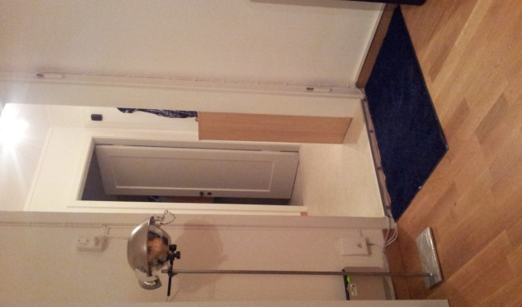

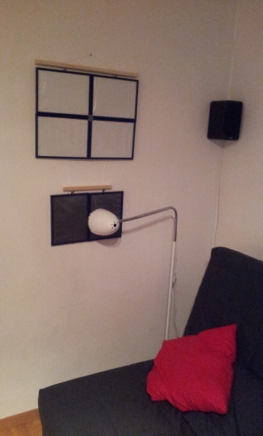
1st field study
spray
S-high
PV-low
PV-high
3 plastic products
PT-low
PT-high
PV
PH-low
PH-high
x 5
12 weeks
carpet
C-low
C-high
PT
httpwww.pixeljoint.compixelart28191.htm

Slide 12
2nd field study
spray
S-high
To check result reproducibility
To investigate dust on different surfaces
PV-high
PT-high
5 plastic products
PH-high
PT-low
x 3
8 weeks
PH-low
carpet
C-low
C-high
httpwww.pixeljoint.compixelart28191.htm

Slide 13
Results
Air
Lifted dust
SOURCE
Dust on the product
Floor dust
Vilma Sukiene

Slide 14


Dust is relevant for substances with log K_{oa} >10;
(consistency within apartments)
1st field study
ng/ m³ air/ g substance*
LODs
PT-plastic (thermal exp.)
PV-plastic vertical
PH-plastic horizontal
C-carpet
S-spray
*concentration in dust normalized by initial source strength (amount of substance in the source)
µg/ g dust/ g substance*
log K_{oa}

Slide 15
Substance distribution in the room
2nd field study: e.g. apartment 3; 8 week samples
avg 2.5x
avg 3.5x
µg/ g dust/ g substance*
avg 2.5x
LODs
avg
PT-plastic (thermal exp.)
PV-plastic vertical
PH-plastic horizontal
C-carpet
S-spray
*concentration in dust normalized by initial source strength (amount of substance in the source)
µg/ g dust/ g substance*
log K_{oa}

Slide 16
Direct transfer increases the concentration in dust
1st field study
  less volatile substances
10⁶
10⁴
µg/ g dust/ g substance*
10²
10
Apartment
Dust on the product
SOURCE - PH

Slide 17
Direct transfer increases the concentration in dust
1st field study
Dust on the product
  less volatile substances
SOURCE - PH
10⁶
10⁴
µg/ g dust/ g substance*
10²
10
Apartment
  more volatile substances
10⁶
10⁴
µg/ g dust/ g substance*
10²
10
Apartment

Slide 18
Direct transfer increases the concentration in dust
1st and 2nd field studies
Dust on the product
  less volatile substances
SOURCE - PH
10⁶
10⁴
µg/ g dust/ g substance*
10²
10
Apartment
  more volatile substances
10⁶
10⁴
µg/ g dust/ g substance*
10²
10
Apartment

Slide 19
Interpathway comparison and case studies (WP4)
Vilma Sukiene

Slide 20
Interpathway comparison
weight fraction 0.1%
weight fraction 0.01%
Figures 13, 14

Slide 21
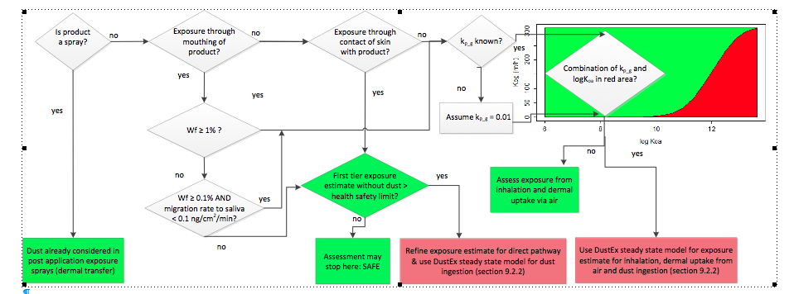
Decision tree

Slide 22
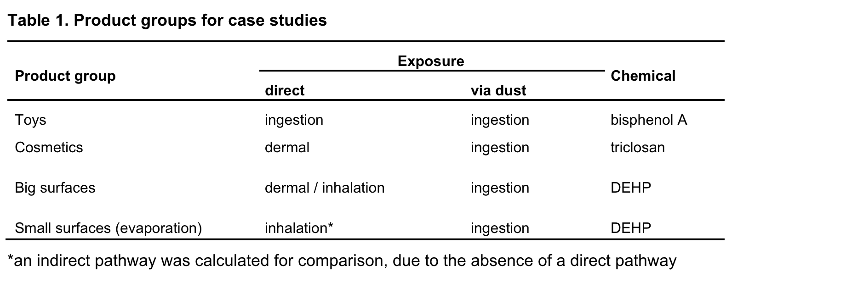
Case studies

Slide 23
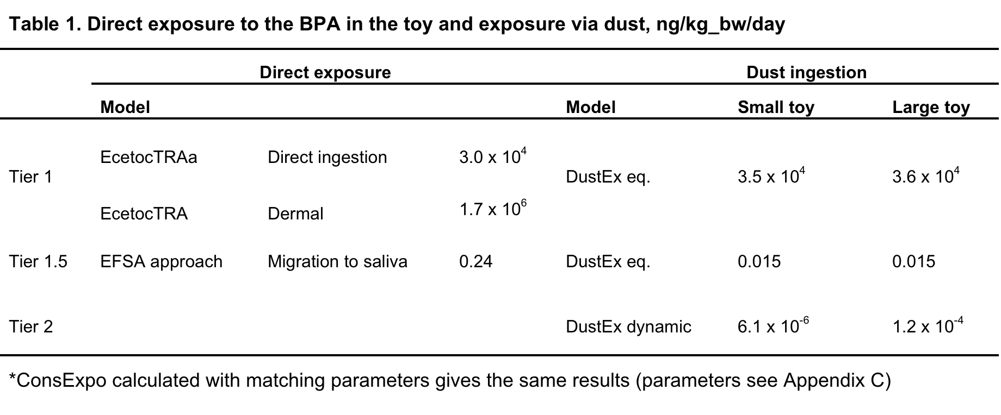
Case study 1 (toy, BPA, Table 21)

Slide 24
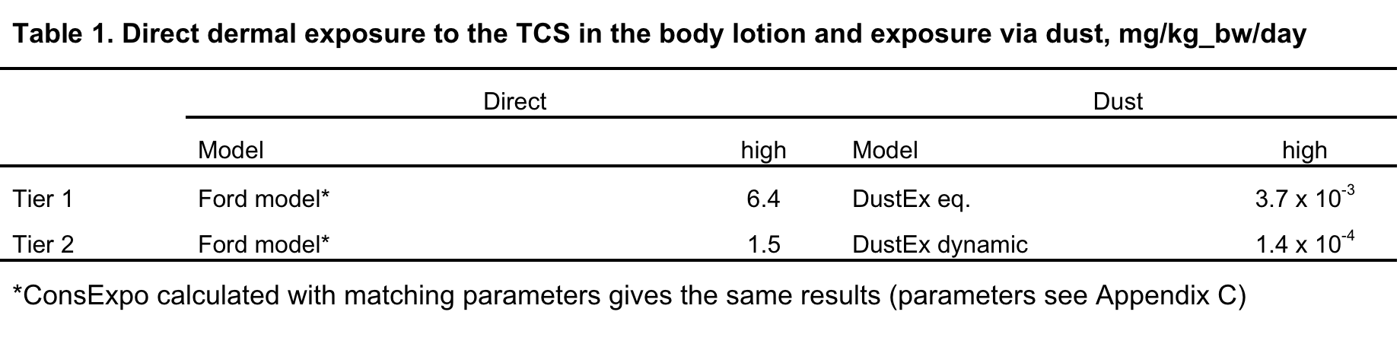
Case study 2 (PCP, triclosan)

Slide 25
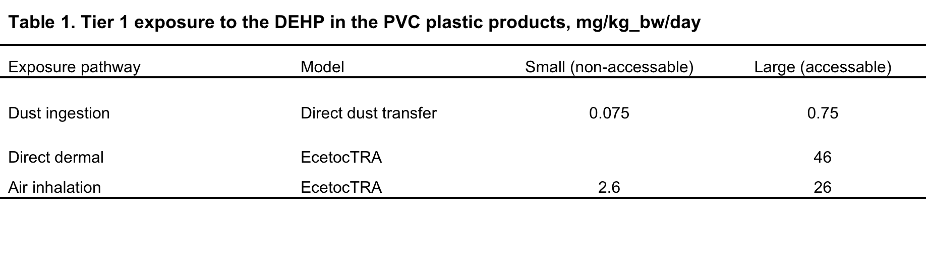
Case study 3,4 (plastic objects, DEHP, Table 28)

Slide 26
Conclusions
New model for transfer of substances from objects to dust
Case studies showing that for most substances and uses at Tier 1 the direct pathway is much more important than ingestion of dust
Koa a very sensitive parameter
Field study: diect transfer from object to dust may be more important than previously assumed

Slide 27
Thank you

