Slide 1
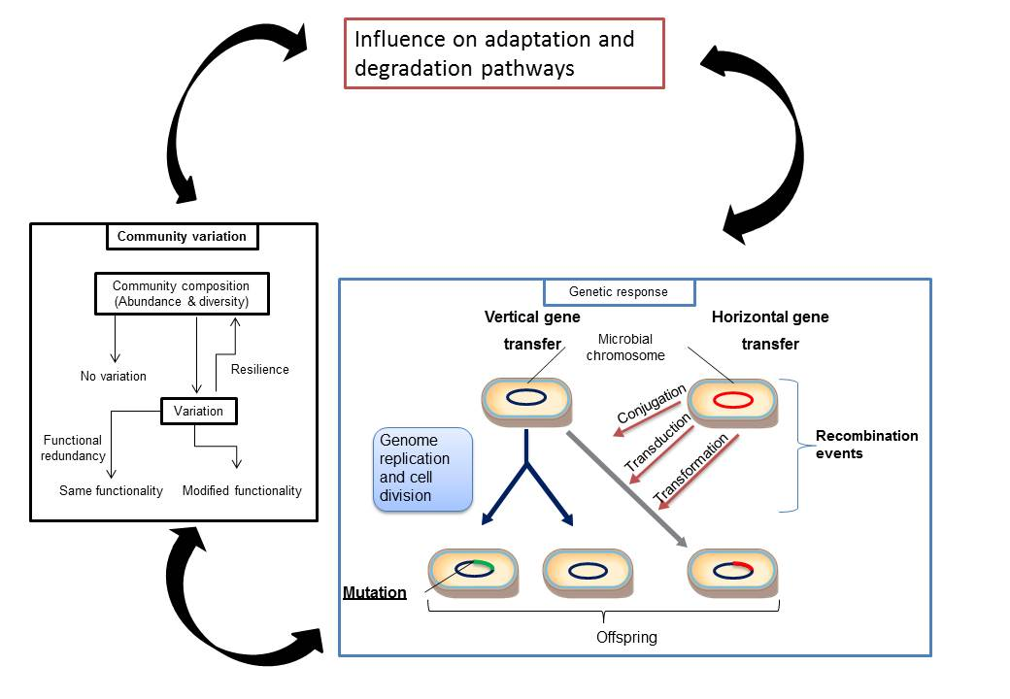
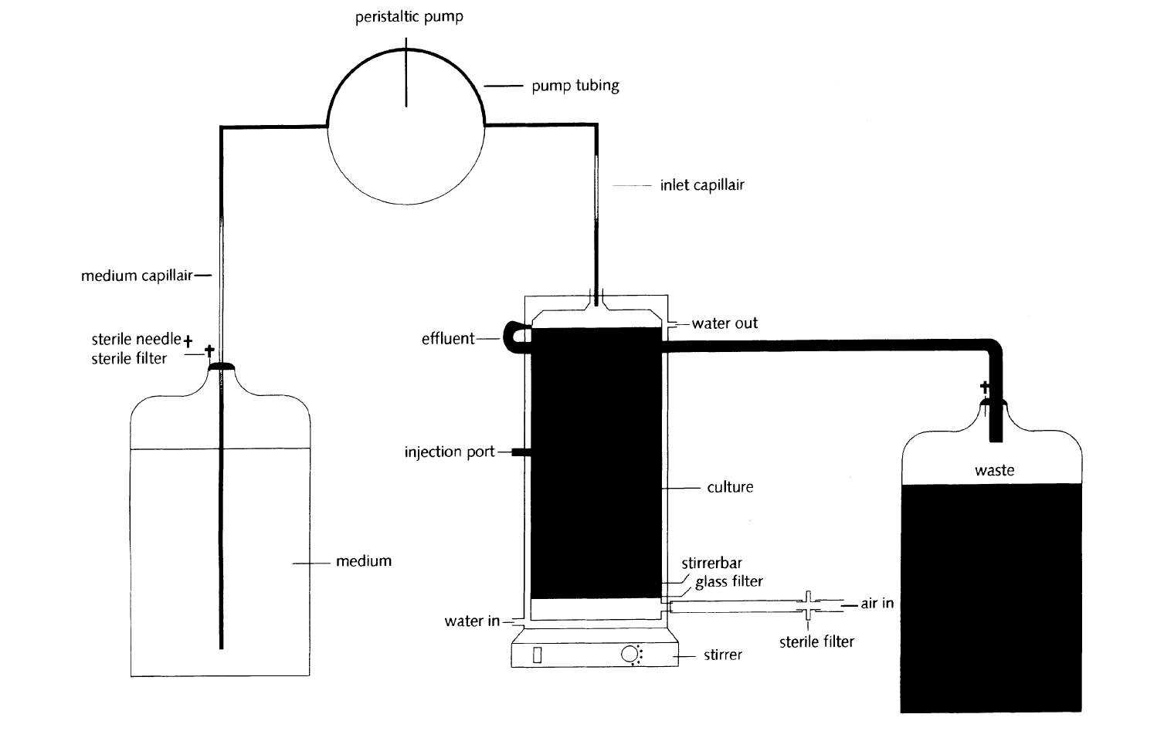
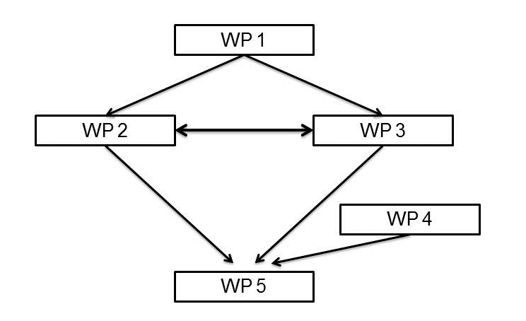
Does microbial adaptation through long term exposure leads to biodegradation of persistent pharmaceutical products? CEFIC-LRI Eco29 “Application of chemostat systems to include adaptation of microbial communities in persistency testing” (CHEMADAPT) (2015-2019) Poursat B.A.J¹., Parsons J.R¹., Röling W.F.M²., de Voogt W.P¹.
¹ : Institute for Biodiversity and Ecosystem Dynamics, University of Amsterdam, Science Park 904, 1098 XH Amsterdam, The Netherlands. ² : Department of Molecular Cell Physiology , Faculty of Earth and Life Sciences, Vrige Universteit, de Boelelaan 1085, 1081 HV Amsterdam, The Netherlands.
Introduction
Persistence in the environment is a key property in assessing the environmental risks of organic chemicals. However, persistency tests are not suited to determining degradation rates under environmentally realistic conditions. The short exposure times do not allow for adaptation of microbial communities to a new chemical, while in the natural environment microorganisms tend to adapt to pollutants upon long term exposure, allowing for the development of efficient and fast degradation over time. The aims of this project, is to study the microbial adaptation to persistent chemicals using continuous culture systems, in order to develop guidelines for persistency tests in which the role of adaptation is accounted for.
Microbial adaptation
Adaptation to chemicals can occur at several levels. These adaptations can lead to an improvement of the microbial fitness and/or of the biodegradation process, and can be spontaneous or due to tested chemicals.
Research questions
The hypotheses and research questions for this project are:
long-term exposure leads to biodegradation of chemicals that are initially persistent.
To what extent is this influenced by environmental conditions (e.g. chemical concentration, nutrient levels, complexity of the microbial community)?
At what level does the community adapt and what is the role of population changes in biodegradation of new chemicals?
Which molecular events contribute to adaptation?
Continuous culture systems
Continuous culture systems (retentostat, chemostat) offer excellent opportunities to allow microorganisms to adapt to new chemicals under defined and environmentally relevant conditions parameters, for in theory, infinite periods of time.
In chemostats fresh medium enters the bioreactor and spent medium and biomass continuously leave the bioreactor. Which means that the most adapted microorganisms will dominate the community.
In retentostats, spent medium leaves the bioreactor but the biomass is retained by the use of a biomass filter, preventing the loss of potentially degrading bacteria and maintaining a high diversity.
Continious culture systems will be used to stabilize environmental microbial communities (e.g. wastewater and surface water communities) and to expose for a long term these communities to a persistent chemicals under defined conditions.
Figure 1: Schematic representation of microbial adaptation at the community and genetic levels.
Project plan
The work in this project will be divided into five work packages listed below:
WP 1: Cultivation of WWTP and surface water microbial communities in chemostats and retentostats.
WP 2: Adaptation to degradable and persistent chemicals by communities in chemostats and retentostats.
WP 3: Effects of nutrient limitations and degradable organic substrates on adaptation to persistent chemicals.
WP 4: Effect of pre-adaptation in continuous culture on ready biodegradability tests.
WP 5: Dissemination of the results
Figure 3: Schematic representation of a chemostat system (Schrap et al, 2000)
Expected results
Results of this project are expect to improve understanding of the role of adaptation in biodegradation of persistent chemicals (e.g. pharmaceutical products) and will contribute to the development of protocols allowing adaptation under standardized conditions to produce microbial communities suitable for use in enhanced screening tests or simulation tests. In order to allow more reliable assessment of environmental persistency than the current methods do.
Figure 2: Representation of the workflow between the differents work pakckages of the project.
CEFIC-LRI, ECO29-UvA: Application of chemostat systems to include adaptation of microbial communities in persistency testing (CHEMADAPT).
Selected references
Schrap, S.M., Van den heuvel, H., van der meulen, J., Ruiter, H., Parsons, J.R., 2000. A chemostat system for investigating pesticide biodegradation in continuous mixed bacteria cultures originating from surface water.pdf. Chemosphere 40, 1389–1397,
van der Meer, J.R., 2006. Environmental pollution promotes selection of microbial degradation pathways. Front. Ecol. Environ. 4, 35–42.
Contact details:
B.A.J.Poursat@uva.nl
J.R.Parsons@uva.nl

